Slide 1
3GPP Long-Term Evolution
In 2004, rollout of Wideband Code Division Multiple Access (WCDMA) systems was happening, the Third Generation Partnership Project (3GPP) industry consortium started to work on fourth-generation (4G) systems.
It was predicted at that time the data rates and spectral efficiencies of WCDMA would not meet the demand of future applications; therefore, a new system had to be developed.
It was decided to completely change both the air interface and the core network.
The air interface was to move to Orthogonal Frequency Division Multiplexing (OFDM) as modulation, and Orthogonal Frequency Division Multiple Access (OFDMA), with (limited) support for Multiple Input Multiple Output system (MIMO) antenna technology.
The core network was to evolve into a pure packet-switched network.
The new standard became known as 3GPP Long-Term Evolution, or simply LTE.

Slide 2
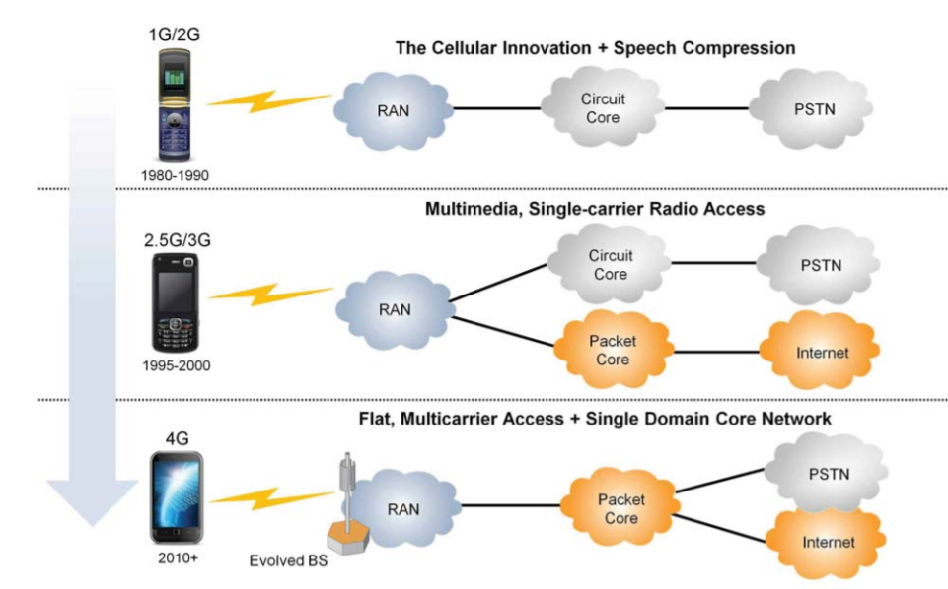
EVOLUTION RECAP AND IMPORTANT HIGHLIGHTS

Slide 3
LTE System Architecture
Increased service provisioning – more services at lower cost with better user experience
Flexibility of use of existing and new frequency bands
Simplified architecture, Open interfaces and allow for reasonable terminal power consumption
LTE has introduced a number of new technologies. LTE to operate more efficiently with respect to the use of spectrum, and also provide the much higher data rates that are now required.
OFDM (Orthogonal Frequency Division Multiplex)
OFDM technology has been incorporated into LTE because it enables high data bandwidths to be transmitted efficiently while still providing a high degree of resilience to reflections and interference.
MIMO (Multiple Input Multiple Output)
By using MIMO, the system can combat with problems associated to multipath mechanism and increase the throughput.
SAE (System Architecture Evolution)
With the very high data rate and low latency requirements for 3G LTE, the system architecture must evolve to achieve the performance improvement benchmarks. One change is that a number of the functions previously handled by the core network have been transferred out to the periphery. Essentially this provides a much "flatter" form of network architecture. In this way latency times can be reduced and data can be routed more directly to its destination.

Slide 4
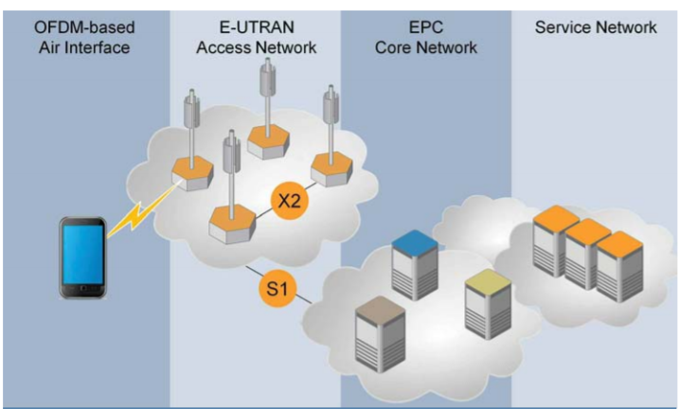
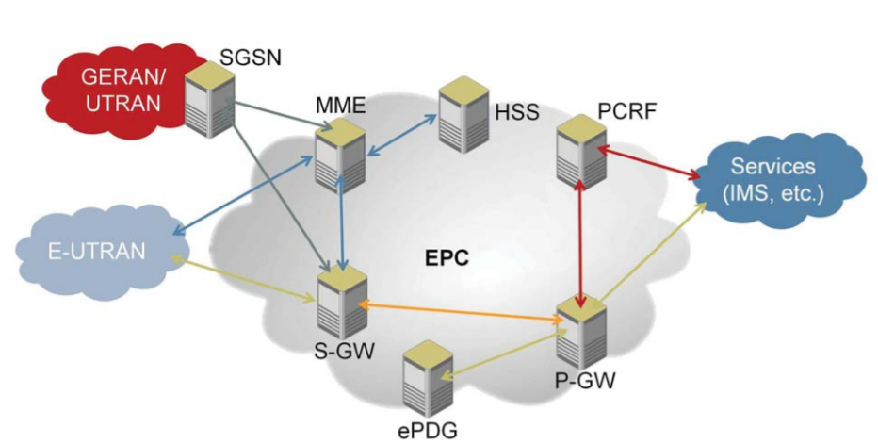
LTE System Architecture
Source: White paper LTE Network Evolution and Technology Overview, 2014
E-UTRAN- Evolved Universal Terrestrial Radio Access
EPC - Evolved Packet Core
LTE ARCHITECTURE
EPC Elements
GSM EDGE Radio Access Network (GERAN), Mobility Management Entity (MME), Serving Gateway (S-GW), Packet Data Network Gateway (P-GW), Home Subscriber Server (HSS), The Policy and Charging Control Function (PCRF), Evolved Packet Data Gateway (ePDG)

Slide 5
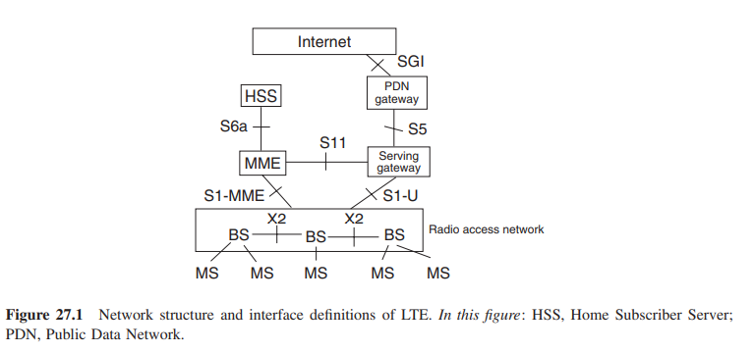
LTE: Architecture/Network Structure
Important Functions:
Mobility management
Subscriber management and charging;
Quality of service provisioning, and policy control of user data flows;
Connection to external networks.

Slide 6
LTE systems
The network structure in LTE is quite simple
There is only a single type of access point, namely, the eNodeB (or BS, in our notation).
Each BS can supply one or more cells, providing the following functionalities:
• air interface communications and PHYsical layer (PHY) functions;
• radio resource allocation/scheduling;
• retransmission control.
The X2 interface is the interface between different BSs. Information that is important for the coordination of transmissions in adjacent cells (e.g., for intercell interference reduction) can be exchanged on this interface.
Each BS is connected by the S1 interface to the core network.
For LTE, a new core network, called System Architecture Evolution (SAE) or Enhanced Packet Core (EPC) was developed. It is based on packet-switched transmission. It consists of (i) a Mobility Management Entity (MME), (ii) the serving gateway (connecting the network to the RAN), and (iii) the packet data network gateway, which connects the network to the Internet.
In addition, the Home Subscriber Server is defined as a separate entity.

Slide 7
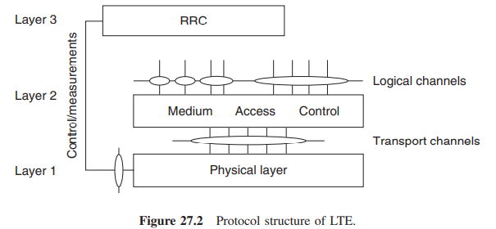
LTE Protocol structure
The transmission protocol of LTE is divided into several layers.
At the top, the Packet Data Convergence Protocol (PDCP) performs functions related to data integrity (like enciphering) and IP header compression. The PDCP hands its packets, called Service Data Units (SDUs) to the Radio Link Control (RLC).
The RLC segments and/or concatenates the SDUs into packets that are more suitable for transmission over the radio channel, the Protocol Data Units (PDUs).
The RLC also makes sure that at the receiver (RX), all PDUs arrive (and arrange for retransmission if they do not) and hand them to the PDCP in their correct order.
The Medium Access Control (MAC) handles the scheduling of the PDUs, as well as the Hybrid Automatic Repeat reQuest (HARQ) for retransmissions on the PHY.2
Finally, the PHY handles all the processes of actually transmitting data over the air, including coding and modulation. Note that the PHY not only interfaces with the MAC layer (layer 2), but also the Radio Resource Control (RRC) of layer 3 .

Slide 8
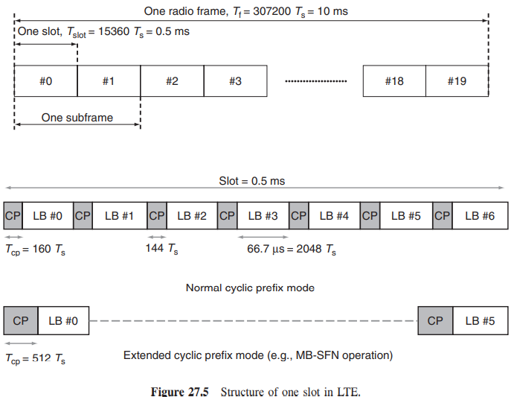
LTE frame structure

Slide 9
LTE frame structure
In LTE, the time axis is divided into entities that play an important role in the transmission of different channels.
These time entities have the following hierarchy
The fundamental time unit of LTE transmission is a radio frame, which has a duration of 10 ms.
Each radio frame is divided into 10 subframes (each being 1ms long). Subframes are the fundamental time unit for most LTE processing, like scheduling.
Each subframe consists of two slots, which are each 0.5 ms long.
Each slot consists of 7 (or 6) symbols.
One subcarrier, for the duration of 1 OFDM symbol, is called a resource element
Time/frequency resources are assigned to different users as integer multiples of a Resource Block (RB)
an RB is 12 subcarriers (180 kHz) over the duration of one slot.

Slide 10
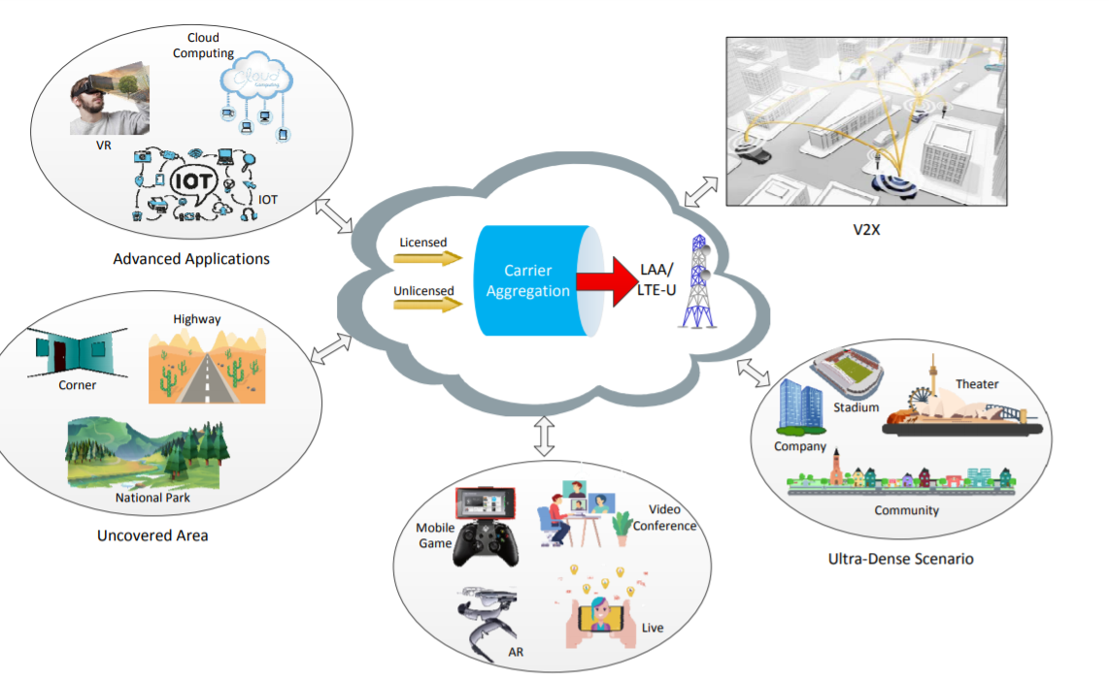
LTE Applications
Source: R. LIU, Q. CHEN, G. YU, G. Y. LI and Z. DING, "Resource Management in LTE-U Systems: Past, Present, and Future," in IEEE Open Journal of Vehicular Technology, vol. 1, pp. 1-17, 2020, doi: 10.1109/OJVT.2019.2949020.

Slide 11
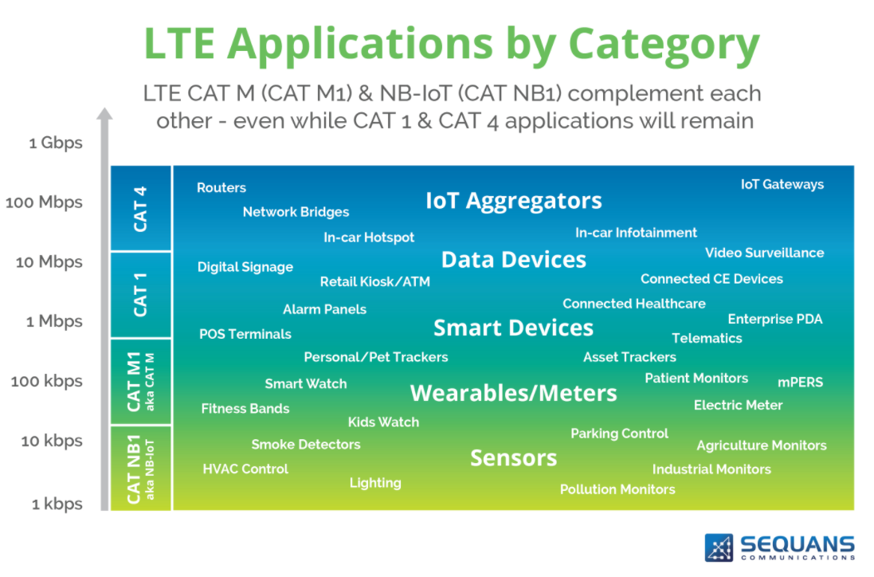
Source:

